Slide 1

Conditional formatting for data visualization

Slide 2
Introduction
Conditional formatting is a powerful feature in Excel that allows to visually highlight, emphasize, or apply specific formatting to cells or ranges of cells based on certain conditions.
★ Conditional formatting is commonly used to emphasize high or low values, identify duplicates, visualize data distribution, and more.
★ This enhances the visual analysis of a data, making it easier to interpret the data by highlighting important information or trends.

Slide 3
Types of ConditionaFormatting 1) Highlight Cells Rules: These rules allow you to highlight cells based on comparison operators (greater than, less than, equal to, etc.) or specific text conditions. 2) Top/Bottom Rules: Highlight the top or bottom values in a range, which is useful for identifying outliers or significant values. 3) Data Bars, Color Scales, and Icon Sets: These options visually represent data using bars, gradients, or icons. They are effective for quickly identifying trends or variations in your data. 4) New Rule: Allows you to create a custom formatting rule using various criteria and formulas.

Slide 4

Steps for Applying Conditional Formatting
1) Select the Range:
Highlight the cells or range of cells where you want to apply conditional formatting.
2) Go to the "Home" Tab:
Conditional formatting options are located in the "Home" tab on the Excel ribbon.
3) Choose a Rule:
Click on "Conditional Formatting" in the ribbon, and you'll see a list of predefined rules. Common rules include data bars, color scales, and icon sets.
4) Set the Rule Parameters:
After selecting a rule, you'll need to set parameters such as the range of values, colors, or icons to be applied based on the specified conditions.
5) Preview and Apply:
Excel will show you a preview of how the formatting will appear. If it looks correct, click "OK" to apply

Slide 5
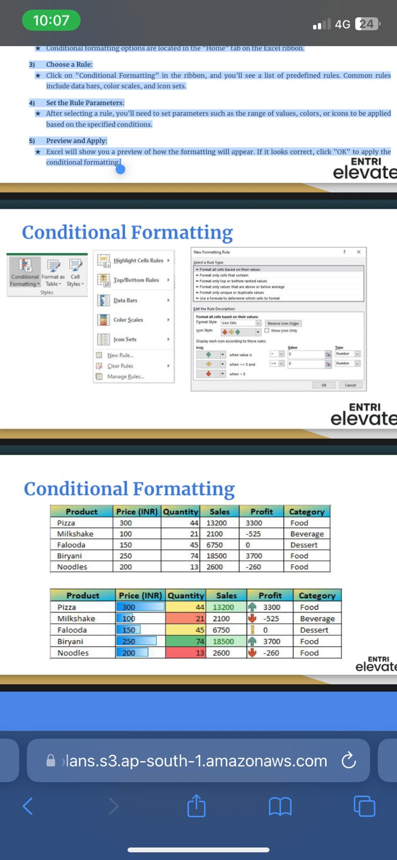

Slide 6
Conclusion Conditional formatting provides visual cues to help you quickly make sense of your data. Every Excel trick you learn makes you one step closer to being proficient and quick in Excel. Moreover, you can spend less time on the spreadsheets and more on the things you love doing.

Slide 7
THANKYOU If you have any question? thahliyamist@gmail.com

